Slide 1
STUDENT : BHARANI.M REGISTER : 2422K1739 NM ID : autbru5h2422K1739 DEGREE : B.Sc Computer Science COLLEGE /UNIVERSITY : Adharsh Vidhyalaya College Of Arts And Science For Women/Bharathiyar University

Slide 2
INTERACTIVE DIGITAL PORTFOLIO USING FRONT AND END DEVELOPMENT

Slide 3
AGENDA
Problem Statement
Project Overview
End Users
Tools And Technologies
Portfolio Design And Layout
Features And Functionality
Results And Screenshot
Conclusion

Slide 4
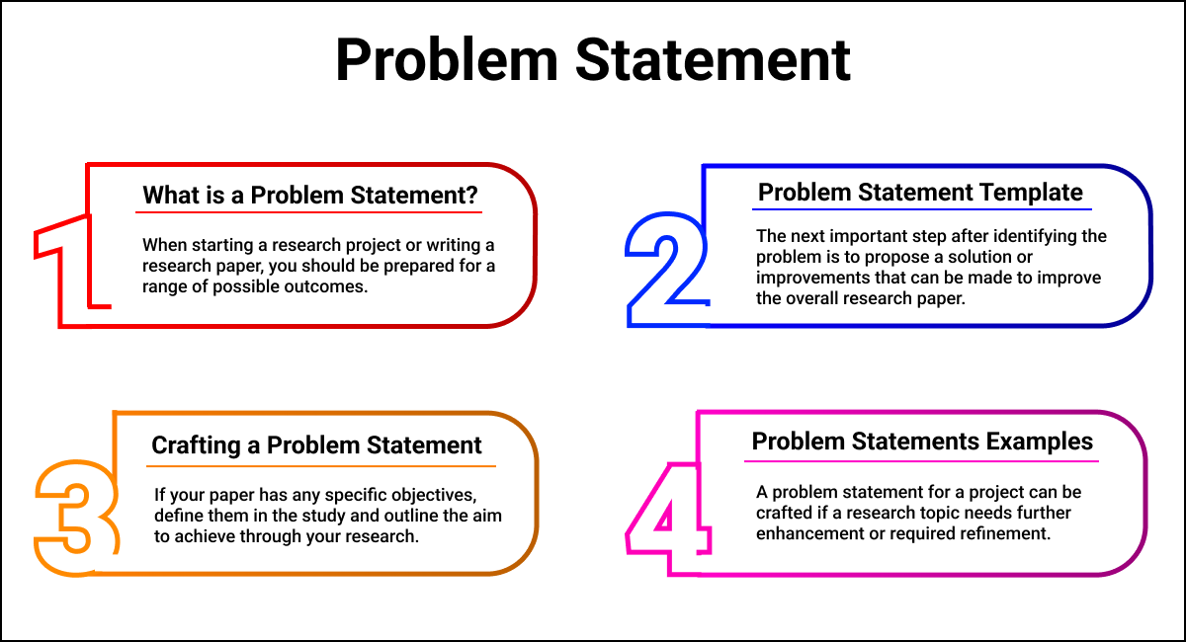
1.Problem Statement: Aspiring and established front-end web developers require an effective and engaging method to showcase their skills, projects, and professional experience to potential employers or clients. Traditional resumes and static online portfolios often lack the dynamic and interactive elements necessary to fully demonstrate a developer's proficiency in front-end technologies and user experience design.

Slide 5
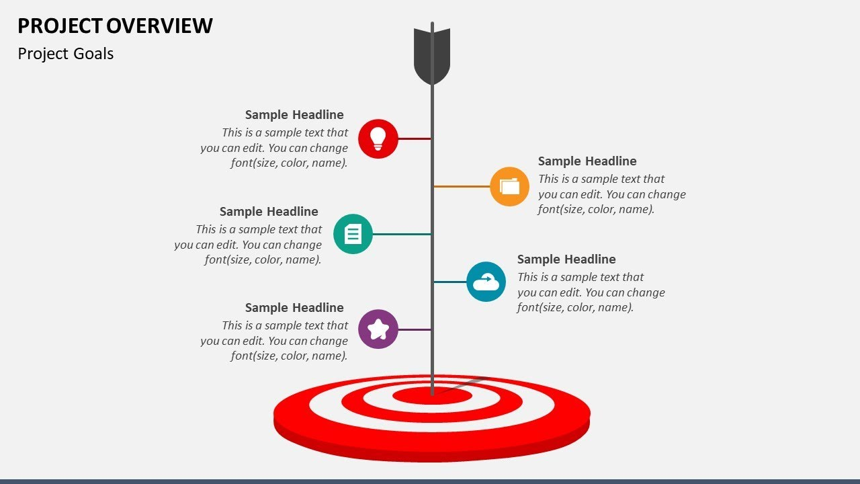
2.Project overview: A summary document that provides a high-level framework of a project, detailing its goals, objectives, scope, key deliverables, timeline, resources, and budget. It serves as a central reference for team members, clients, and stakeholders to ensure everyone is aligned on the project's purpose and expected project initiation phase to gain support and outcomes

Slide 6
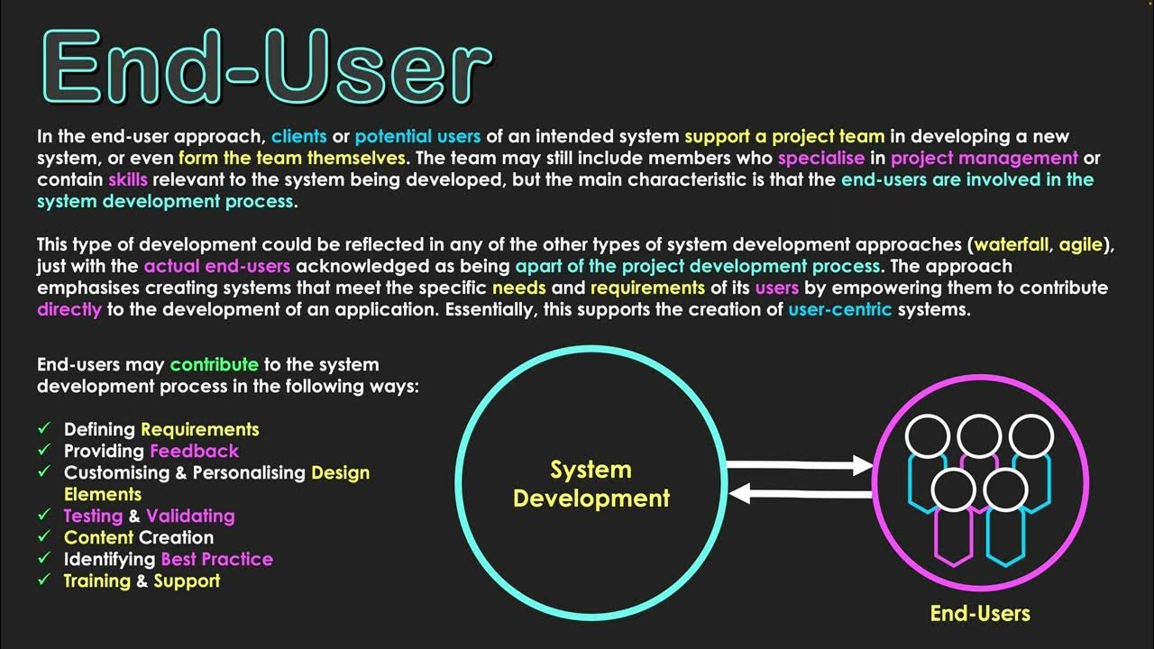
3.End users
In a literal sense, the term is used to distinguish the person who purchases and uses the good or service from individuals who are involved in the stages of its design, development, and production.

Slide 7
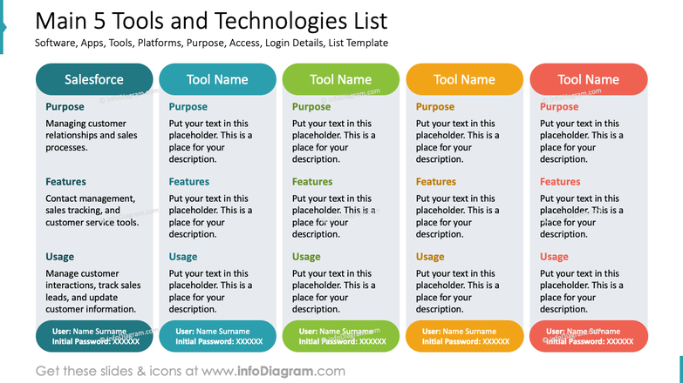
4.Tools and technologies
the knowledge, processes, systems, and applicaa tool is a specific device, implement, or software that performs a particular task, while technology is a broader concept encompassing tions that allow us to solve problems or achieve goals, often by combining various tools. For example, a hammer is a tool for building

Slide 8
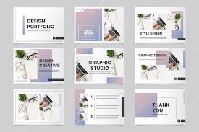
5.Portfolio Design and layout
Portfolio design refers to the overarching visual style, branding, and storytelling of your professional presentation, while the layout is the specific arrangement of elements (like images, text, and case studies) on a page or screen to guide the viewer's experience and effectively showcase your work and problem-solving

Slide 9
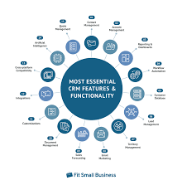
6.Features and Functionality
Features are the tangible attributes or components of a product or service, such as a smartphone's camera or a software's user interface. Functionality describes the actions and overall capabilities of the product or servicefulfill user needs and provide , including how well it performs its tasks to value.

Slide 10
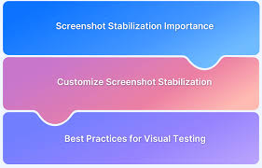
7.Results and Screenshot
To get "results and screenshot," use the built-in features of your operating system or a third-party tool to capture an image of your screen and then view the results of a process, such as test results, by finding them in a test report or by running a screenshot test. On Android, press the Power and Volume Down buttons. On Windows, press Windows key + Shift + S to open the Snipping Tool. For automated testing, you can use tools like Selenium to take screenshots of web pages, or use screenshot testing to compare UI components against reference images.
To get "results and screenshot," use the built-in features of your operating system or a third-party tool to capture an image of your screen and then view the results of a process, such as test results, by finding them in a test report or by running a screenshot test

Slide 11
8.Conclusion
The conclusion of creating an interactive digital portfolio using front-end web development emphasizes its crucial role in showcasing skills and attracting opportunities. It is a dynamic and evolving representation of a developer's capabilities, going beyond a static resume to offer an immersive experience of their work.

